Slide 1
Amazon Sales Data Analysis
Detailed Project
Sikha Pandey

Slide 2
Project Detail
Project Title | Heart Disease Diagnostic Analysis
Technology | Business Intelligence
Domain | E-commerce
Project Difficulty Level | Advanced
Programming Language Uses | Python
Tools Used | Jupyter, Power Bi, Excel, PowerPoint

Slide 3
Objective:
The goal of this project is to analyze heart disease occurrence based on a combination of features that describe heart disease.

Slide 4
Problem Statement:
Finding sales profit analysis yearly wise, monthly wise, and daily wise.

Slide 5
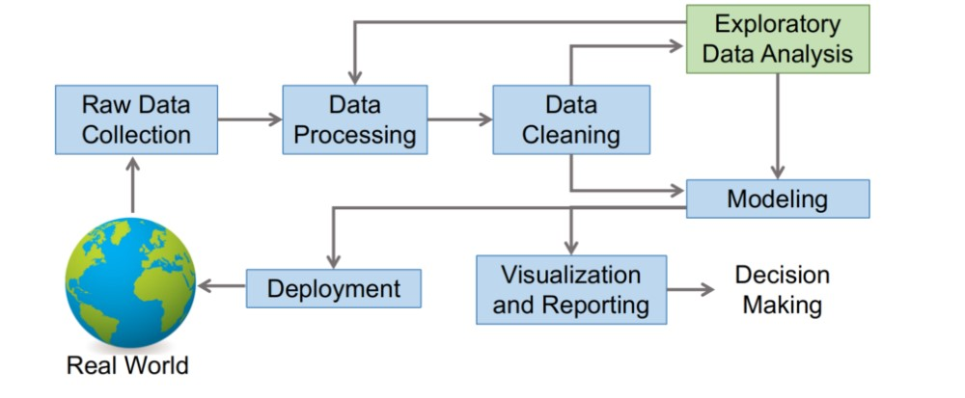
Architecture

Slide 6
Dataset Information :
Invoice Date: Day on which the invoice is generated.
Discount Amount: Total discount provided on any item.
Sales Amount: Total Sales Price of an item.
Sales Margin Amount(Profit): Sales Margin Amount is a difference of Sales Cost Amount and Sales Amount.
Sales Price: Sales Price of any particular Item.
List Price: The basic price of an item as published on the price list.
Sales Rep: A person who is in charge of selling the product or services for the company.
U/M: Unit of Measure.
CustKey: It is a unique number on the Invoice that is used to reference customer’s accounts.

Slide 7
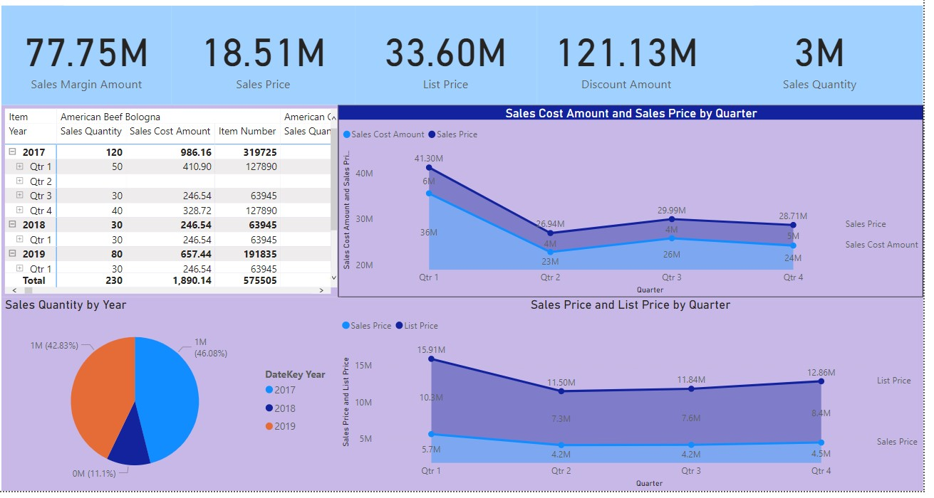
* Sales report of amazon data by quarterly, yearly, and items sold in that year.

Slide 8
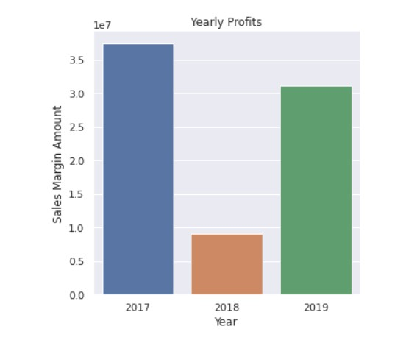
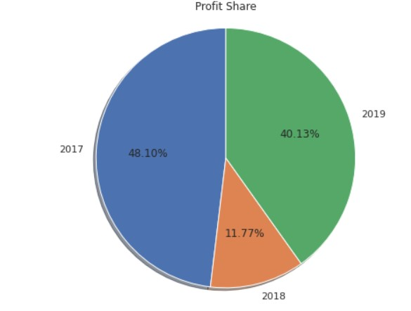
Yearly Profit :
According to sales margin amount 2017 has been the most profitable year.

Slide 9
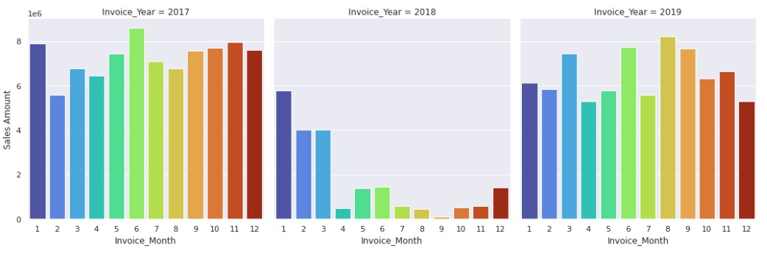
2018 has been the least sales year..
Yearly Invoice:

Slide 10
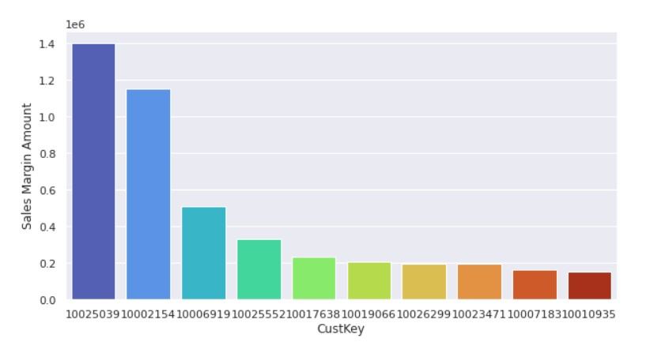
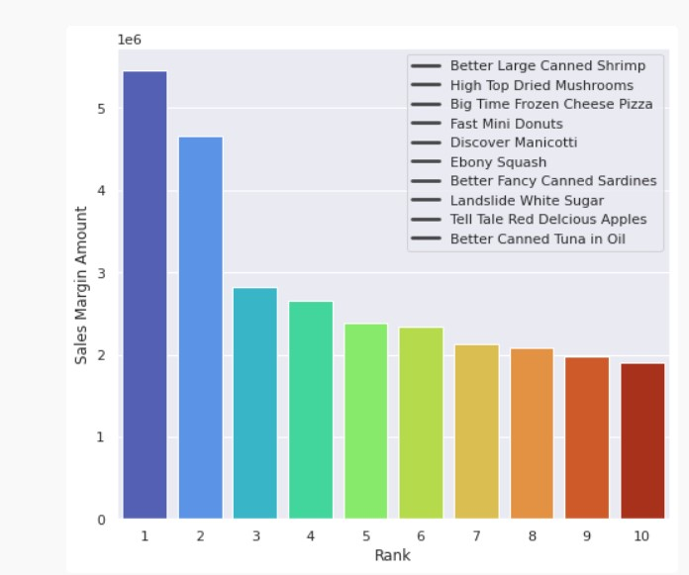
Customer who gave the highest sales:
Customer with id 10025039 has given the highest sales.
Better large canned shrimp is the item which have been sold the most .

Slide 11
Key Performance Indicator (KPI)
Overall sales on a yearly and quarterly basis.
Which year gave the most profit and their distribution.
Sales on a monthly basis distribution.
Customer who gave the highest number of sales.
Items which was mostly sold.

Slide 12
Conclusion
2017 was the most profitable year.
Profit share in the three years 2017, 2018, and 2019 are 48.10%, 11.77%, and 40.13% respectively.
On 06/2017 the most number of items were sold.
Customer who has bought the highest number of items is 10025039.
Better Large Canned Shrimp is the item that was sold the most.

Slide 13
Q&A
Q 1) What is the source of the data?
Ans- The dataset was taken from iNeuron.ai provided project description document.
https://drive.google.com/drive/folders/1FkmFVL8wlJmQWP1z52TD8PlhOJhitTyI?usp=s
haring
Q2) What was the type of data?
Ans- The data was both a combination of numerical and categorical data.
Q3) What Technique are used are used for data?
Ans- Removing unwanted attributes
- Removing outliers
- Cleaning data and checking null values.
- Converting Numerical data into categorical data.
- Visualizing relation of independent variables and with each other output variables.
Q4) what were the libraries used in python?
Ans- Pandas, Numpy, matplotlib, and Seaborn

Slide 14
Thank You

